Slide 1
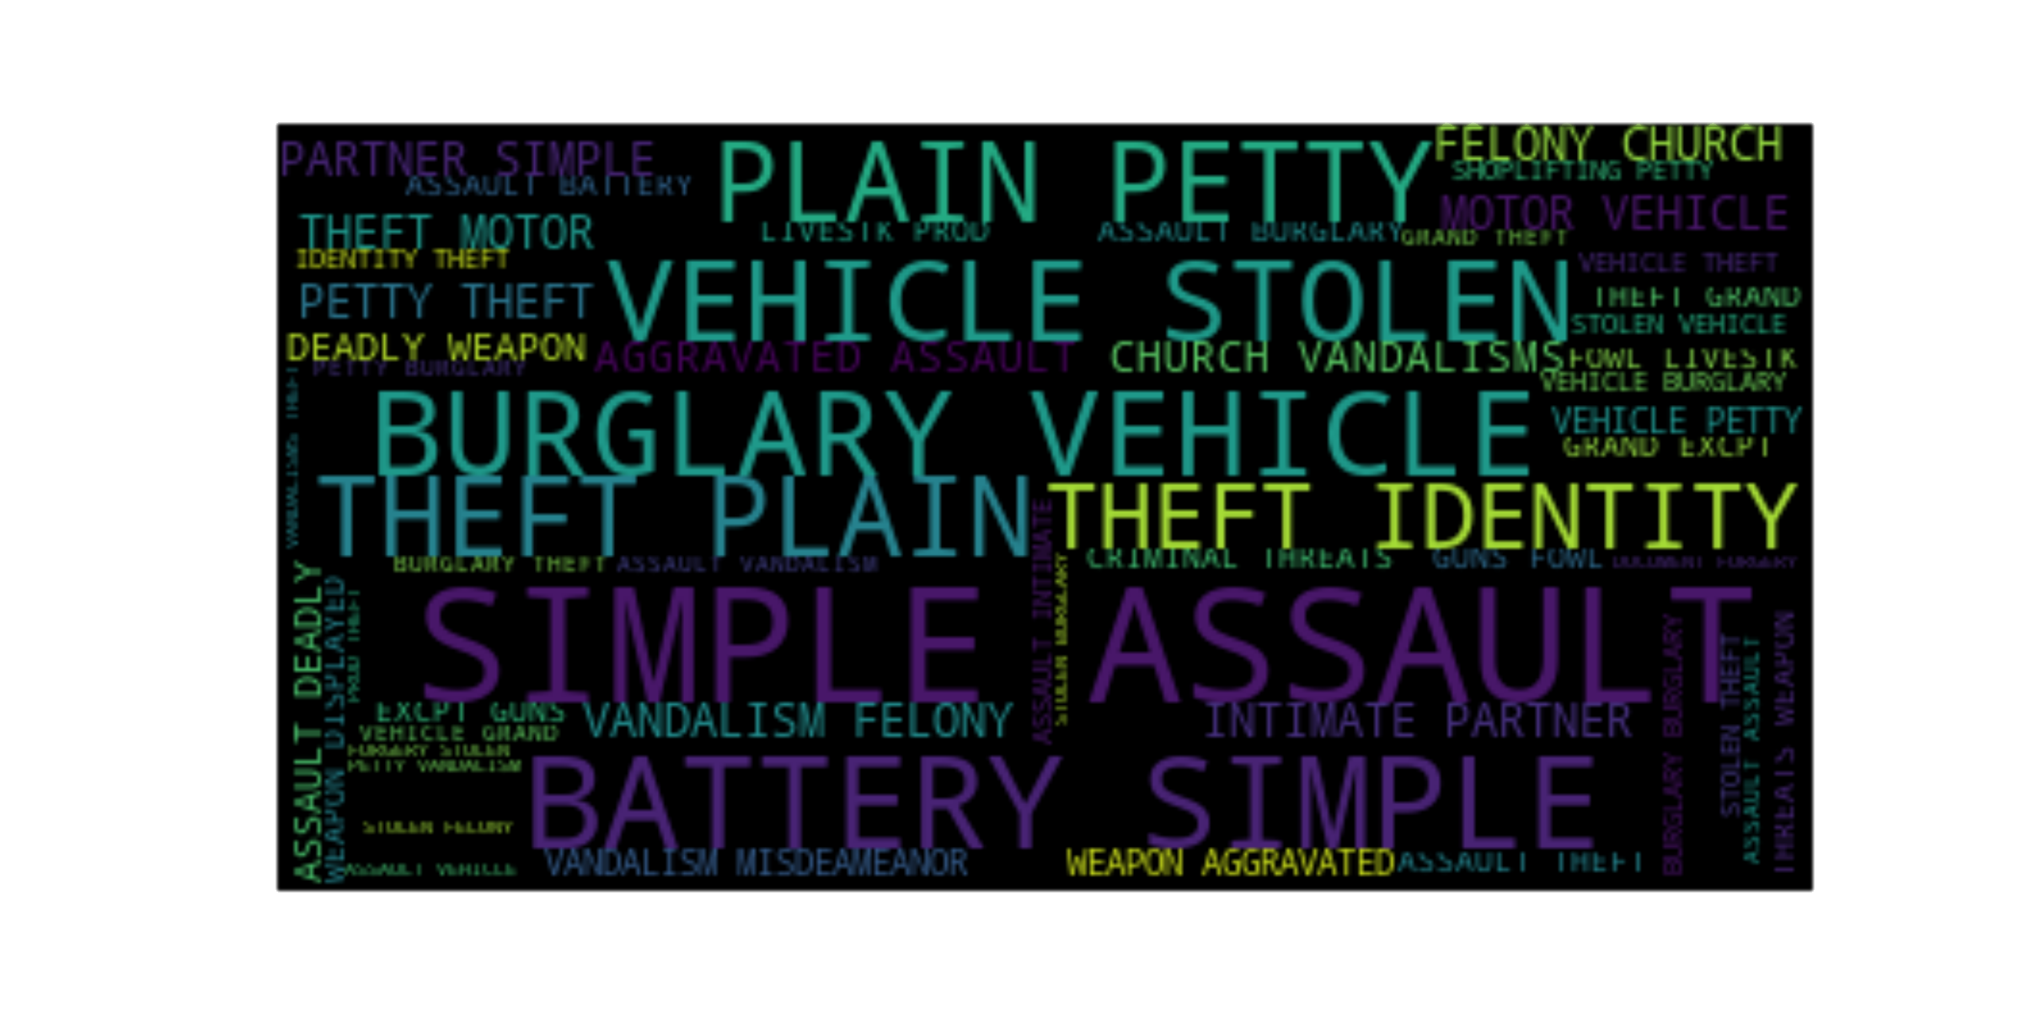
Rice University Data Analytics Boot Camp
Project 1 - Information, Insights, and Analysis from the City of Los Angeles – Crime – 2010 through 2018
Frederik De Bruyker / Ehsan Khan / Jeff Mackey

Slide 2
Top Violent Crimes Disparity by Zip Code
Top 10% account for 43.66 %
Top 20 % account for 65.19 %

Slide 3
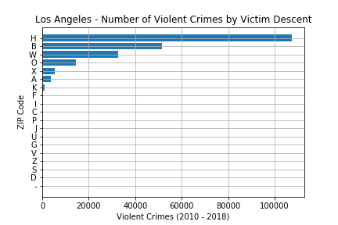
Expectation versus Data: Violent Crime Victim Descent
Expectation:
Close % of Hispanic / Black victims
Data:
49.56 % of Hispanic descent
Black / White crime not dramatically different
Descent | Percentage
Hispanic | 49.56%
Black | 23.80%
White | 15.10%

Slide 4
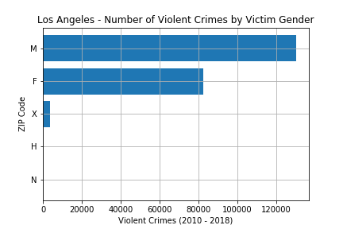
Expectation versus Data: Violent Crime Victim Gender
Expectation:
Higher % of female victim
Data:
60.15% are male

Slide 5

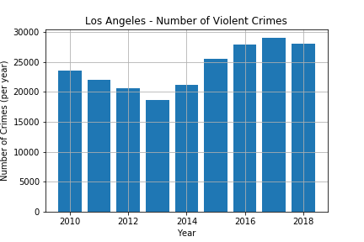
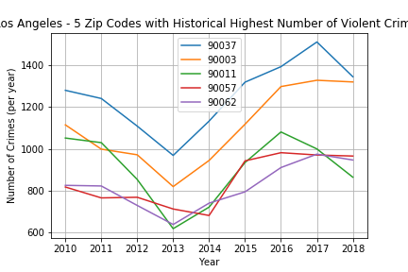
News Validation: 2018 versus 2017 : Overall Violent Crime
News article:
Violent crime: 2018: 27,246
Decrease of near to 4 %
https://www.latimes.com/local/lanow/la-me-lapd-crime-stats-20181229-story.html
Analysis:
Violent crime: 2018: 27,991 (from 2017: 29,045)
Decrease of 3.63 %

Slide 6
News validation: Issues
No fixed definition of violent crime
Analysis only as good as underlying data
Stark local differences
Changing perception
Notes:
No fixed definition of what constitutes violent crime
The LA Times article describes violent crime as 'violent crime — which includes homicide, rape, robbery and aggravated assault‘
Efforts on going to classify crime (https://www.nap.edu/read/23492/chapter/7#121)
The data analysis can only be as good as the underlying data
The LA Times article states that more then 25,000 serious crimes were classified as minor
https://www.latimes.com/local/crime/la-me-lapd-audit-20151206-story.html
Overall conclusion violent crime decrease sounds good, but local stark differences
How to account for changing perception of what constitutes a crime and/or what people consider ‘normal/acceptable’ behavior over time

Slide 7
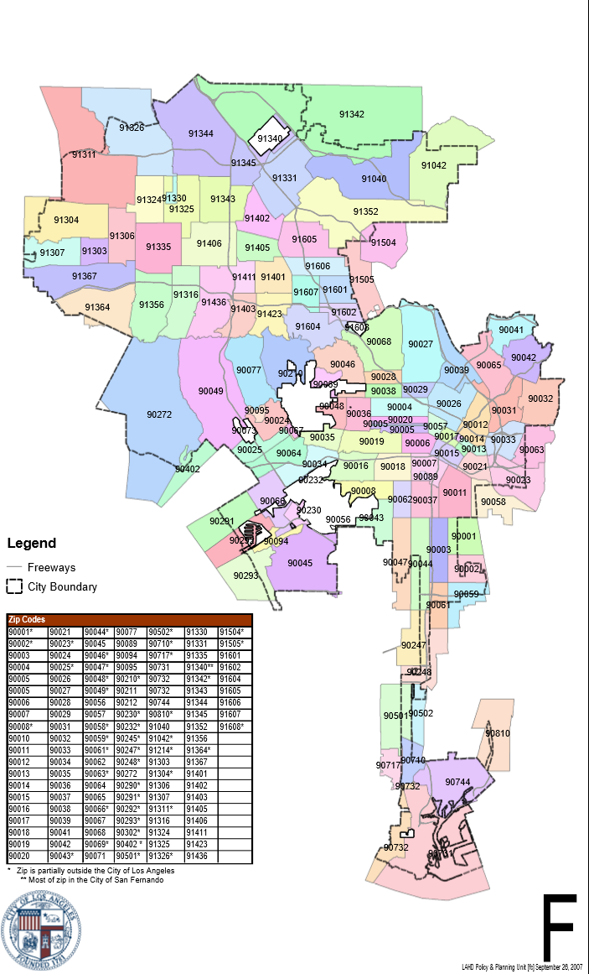
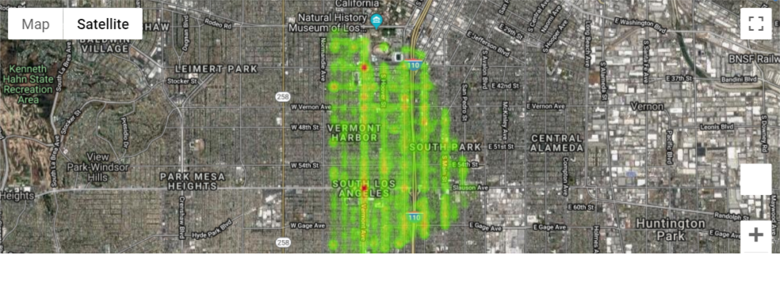
Which zip codes not to live in LA?
90037, 90003, 90011, 90057, 90062

Slide 8
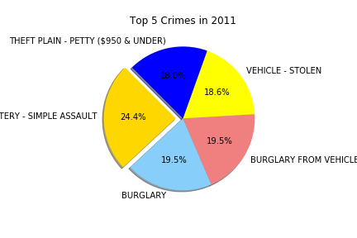
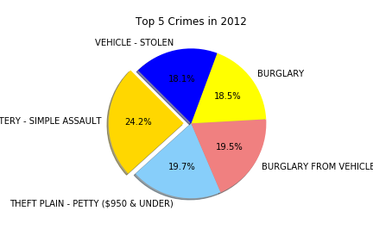
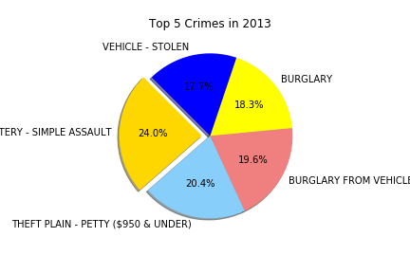
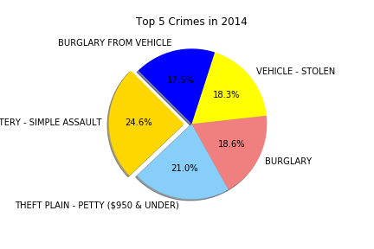
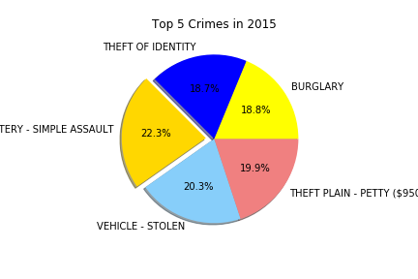
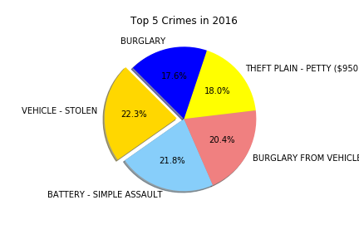
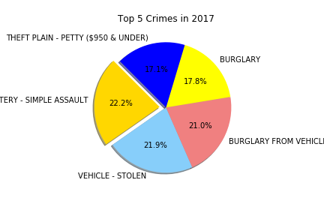
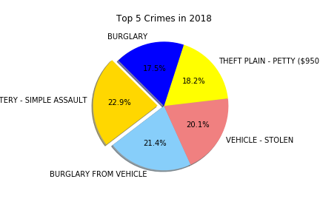
Are the top crime changing?

Slide 9
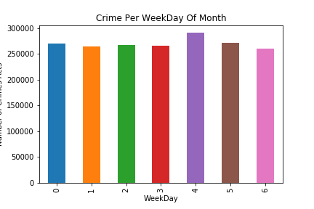
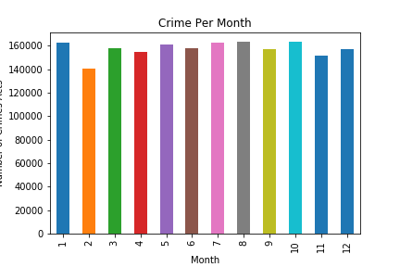
Are Some Months/Days Safer for Los Angeles Residents?

Slide 10
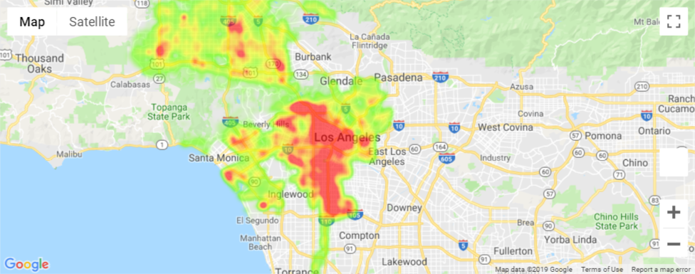
Is It Safe to Live in Los Angeles?

Slide 11
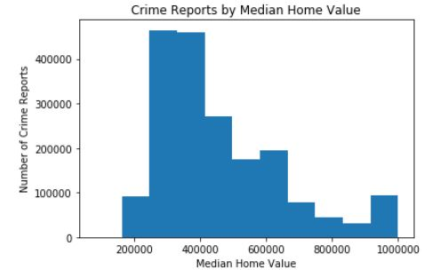
Effects of Property Values on Crime Rates

Slide 12
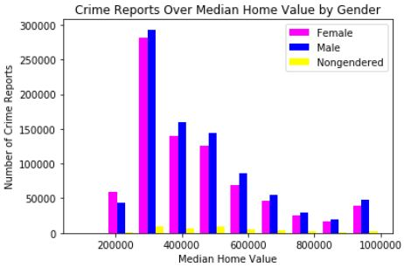
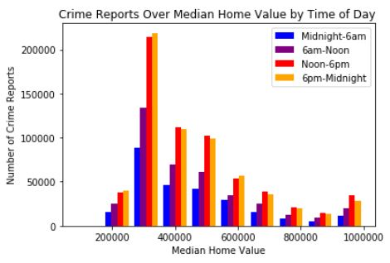
Effects of Property Values on Crime Rates: Other Views

Slide 13
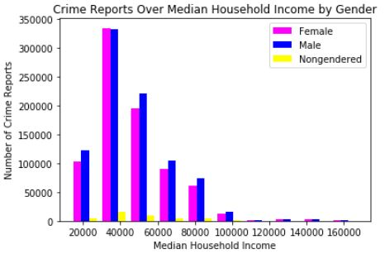
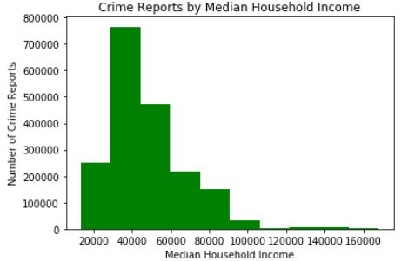
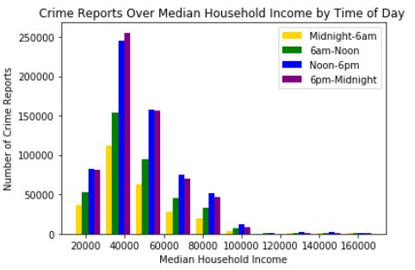
Effects of Median Income on Crime Rates

